Slide 1
Library Orientation Programme
Presented by :
Dr. Pinaki Ranjan Bhattacharyya
Chairman, Library Committee
&
Mr. Atanu Ganguly
Assistant Librarian

Slide 2
Know your Library
Total Books: 7819
Total Journal & Magazine (Print version): 30
Newspaper: 07
Library Team:
1. Mr. Atanu Ganguly, Assistant Librarian
2. Mr. Nazim Mistry, Senior Library Attendant
3. Mr. Ramesh Chandra Paul, Junior Library Attendant
For any Issues, Grievances, Problems, Request & Suggestions:
Dr. Pinaki Ranjan Bhattacharyya, Chairperson, Library Committee
pinakirb@calcuttabusinessschool.org
2. Mr. Atanu Ganguly, Member Library Committee
atanug@calcuttabusinessschool.org

Slide 3
Entrance Keep your bags in Baggage Counter

Slide 4
Entry to Library

Slide 5
New additions

Slide 6
Journal/Magazine section

Slide 7
News paper

Slide 8
Stack room : Open Access

Slide 9
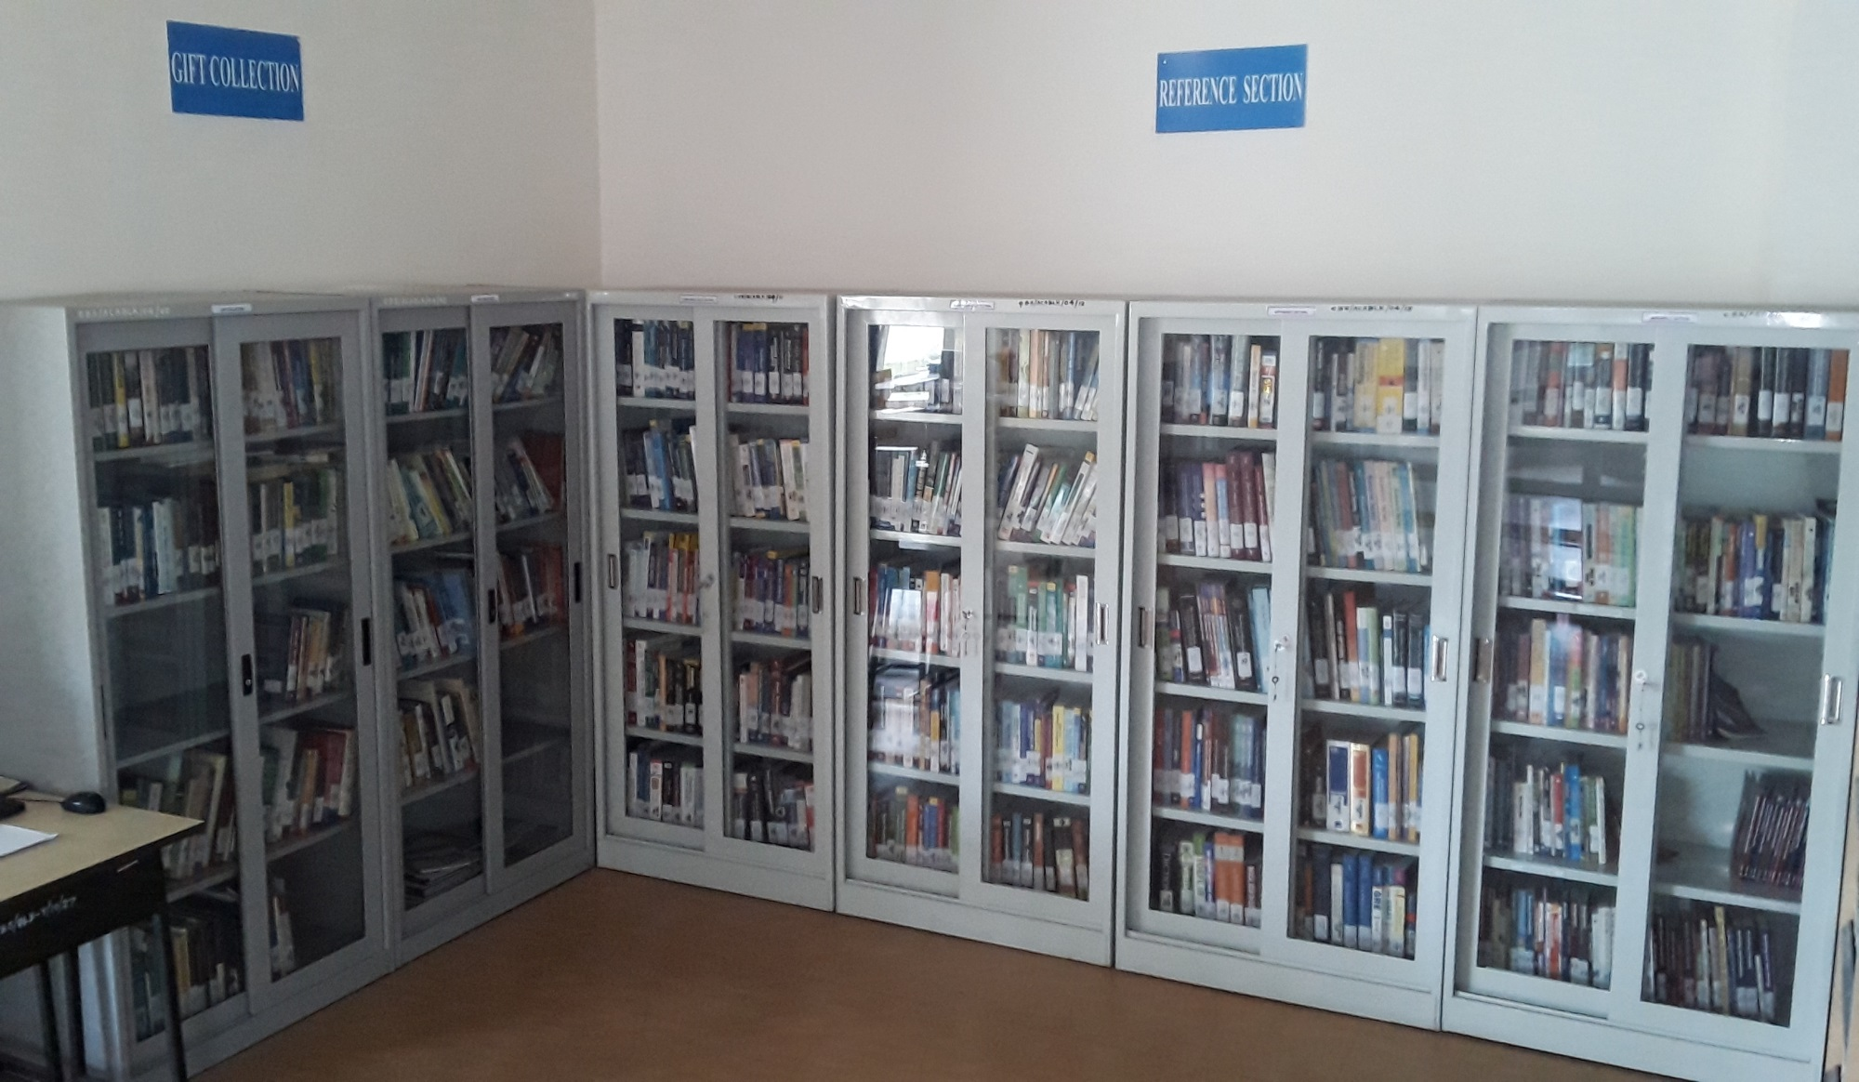
Gift & Reference Section

Slide 10
Self study

Slide 11
Digital library

Slide 12
Reading room 9.30am -9.30 pm

Slide 13
Help desk

Slide 14
Circulation counter (10am-12.30pm & 1.30pm-5.30pm)

Slide 15
Institutional Membership
1. DELNET
http://delnet.nic.in/
[login & password which will be supplied during access]
2. National Digital Library (NDL)
https://ndl.iitkgp.ac.in/
[use your personal ID and password after registration.]

Slide 16
E-Journal Database
EBSCO
http://search.ebscohost.com
[login & password which will be supplied during access]
Sage Online
http://online.sagepub.com
[login & password which will be supplied during access]

Slide 17
Course Materials (Video Lectures)
NPTEL
National Programme on Technology Enhanced Learning which is an initiative by Indian Institutes of Technology (IITs) & Indian Institute of Science (IISc)
Contents for the above courses were based on the model curriculum suggested by All India Council for Technical Education (AICTE) and the syllabi of major affiliating Universities in India.
http://nptel.ac.in/course.php

Slide 18
E-Books
ProQuest’s Business Ebook
It offers anytime, anywhere access to more than 21,500 ebooks that meet the needs of academic, community college, and business school libraries. It including Oxford University Press, Copenhagen Business School Press, Princeton University Press, Hong Kong University Press, Amsterdam University Press, and Stanford University Press. Other key contributing publishers include Bloomsbury Press, Kogan Page, No Starch Press, AMACOM, Taylor & Francis, Elsevier Science, Emerald Group Publishing, Wiley, Sage, CUP, Himalaya Publishing, New Age and BRILL Publishers
To access Ebook:
https://ebookcentral.proquest.com/lib/calcuttabusinessschool

Slide 19
Other Resources
e-PG Pathshala
e-PG Pathshala is an initiative of the MHRD under its National Mission of Education through ICT (NME-ICT) 22,000 e-modules are available It provide high quality, curriculum-based, interactive content of 70 subjects across all disciplines of social sciences, arts, fine arts & humanities, natural & mathematical sciences.
Visit: www.epgp.inflibnet.ac.in
or
https://sakshat.ac.in/?project=e-pg-pathshala

Slide 20
Other Resources
PARAKH
Student’s Learning Assessment Portal
It is designed to measure the benchmark levels and gains in academic and aptitude skills by the students in technical programs and to understand the various factors that affect skill development of students in Technical Institutes across India.
https://parakh.aicte-india.org/login

Slide 21
Other Resources
SWAYAM
It is a programme initiated by Government of India and designed to achieve the three cardinal principles of Education Policy viz., access, equity and quality. The objective of this effort is to take the best teaching learning resources to all, including the most disadvantaged. SWAYAM seeks to bridge the digital divide for students who have hitherto remained untouched by the digital revolution and have not been able to join the mainstream of the knowledge economy.
https://swayam.gov.in/about

Slide 22
Other Resources
SWAYAM- PRABHA
It is a group of 34 DTH channels devoted to telecasting of high-quality educational programmes on 24X7 basis using the GSAT-15 satellite. Every day, there will be new content for at least (4) hours which would be repeated 5 more times in a day, allowing the students to choose the time of their convenience. The channels are uplinked from BISAG, Gandhinagar. The contents are provided by NPTEL, IITs, UGC, CEC, IGNOU. The INFLIBNET Centre maintains the web portal.
https://www.swayamprabha.gov.in/

Slide 23
Other Resources
CMIE-Prowess
Developed by
Centre for Monitoring Indian Economy Pvt. Ltd.
Prowess is a database of the financial performance of over 27,000 companies. It includes all companies traded on the National Stock Exchange and the Bombay Stock Exchange, thousands of unlisted public limited companies and hundreds of private limited companies.
The Prowess database is built from Annual Reports, quarterly financial statements, Stock Exchange feeds and other reliable sources. There are over 3,500 data fields per company in Prowess.

Slide 24
Motto of Library
Documents are for use
Every User his/her documents
Every documents its User
Save time of User
Library is a growing organism

Slide 25
THANK YOU

